Slide 1



Abstraction & Specification
Abstraction
Specification
Implementation
Type * values;
size_t size;
Vector
element
push_back(element)
This Photo by Unknown Author is licensed under CC BY
This Photo by Unknown Author is licensed under CC BY

Slide 2

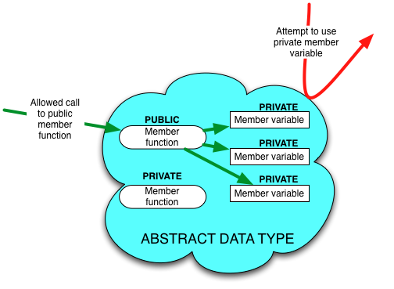
OOP for Abstraction
Designing for Abstraction in OOP:
Make all member variables private
Make the basic operations public and specify how to use them
Make any helping functions private
Notes:
What is abstraction?
You don’t need to know the mother’s name of your bus driver to catch the bus

Slide 3
ADT for a Set
Abstraction
A collection of non-repeated values
Unordered and unindexed
Specification
What functions do we need to use the Set ADT?
Anything in the specification is public
Everything else is private (or possibly protected if child class requires direct access)

Slide 4
Implementation
Demo

Slide 5
Exercise
Identify and fix problems with incorrect Player abstraction & implementation

